Slide 1
Olist Store Analysis
Group 5:
Ananya dp
Aboli Wankhede
Harsha rajesh
Harshwardhan Bhosale
Prabhas
Rafeek
siddhesh

Slide 2
INTRODUCTION
Domain: E-Commerce
Project Title: Olist Store Analysis
Description:This project focuses on analyzing e-commerce sales data from the Olist platform to understand customer behavior, payment patterns, delivery performance, and review scores.
Objective:To extract meaningful insights from large datasets using SQL, Excel,Tableau and Power BI and present them through interactive dashboards.

Slide 3
DATA OVERVIEW
Dataset Source: Olist E-commerce Dataset
Dataset Type: CSV
FilesTotal Files Used: 9
Total Size: ~45 MB
Key Tables Used:Customers dataset,Orders dataset,Payments dataset,Reviews dataset,Products dataset,Order items dataset
Data Content Includes:Customer details, order dates, delivery dates, payment types, review scores, product categories, and prices.

Slide 4
OBJECTIVES:KPI’s
1) Weekday Vs Weekend (order_purchase_timestamp) Payment Statistics
2) Number of Orders with review score 5 and payment type as credit card.
3) Average number of days taken for order_delivered_customer_date for pet_shop
4) Average price and payment values from customers of sao paulo city
5) Relationship between shipping days (order_delivered_customer_date - order_purchase_timestamp) Vs review scores.

Slide 5
PROCESS
Collected and understood the Olist dataset
Cleaned and prepared data in Excel
Imported datasets into SQL
Wrote SQL queries for KPIs and insights
Connected SQL output to Power BI
Created interactive dashboards
Analyzed results and interpreted insights

Slide 6
ANALYSIS
Weekday transactions are significantly higher than weekend transactions, indicating customers prefer shopping during weekdays.
Credit card is the most frequently used payment method.
Faster delivery results in higher review scores, showing a strong relationship between shipping time and customer satisfaction.
Orders with shorter delivery days received more 5-star ratings.
São Paulo city shows higher average payment value and average product price compared to other regions.
Pet Shop category has a moderate average delivery time compared to other product categories.
Higher number of orders reflects strong customer engagement on the Olist platform.
Data visualization through dashboards helped identify trends, patterns, and business insights effectively

Slide 7
CHALLENGES
Handling large datasets with multiple tables
Writing complex SQL joins
Managing missing and null values
Connecting SQL results correctly to Power BI
Designing dashboards that are simple and meaningful.

Slide 8
LEARNINGS
Gained hands-on experience with real-world e-commerce data
Improved SQL query writing skills
Learned data visualization best practices
Understood customer behavior through data
Improved analytical and problem-solving skills

Slide 9
CONCLUSION
The Olist Store Analysis provides valuable insights into customer behavior, payment trends, and delivery performance.
Faster delivery improves customer satisfaction and review scores.
Credit cards are the most preferred payment method.
Data-driven analysis helps businesses make better decisions.
This project strengthened practical knowledge in SQL, Excel,Tableau and Power BI

Slide 10
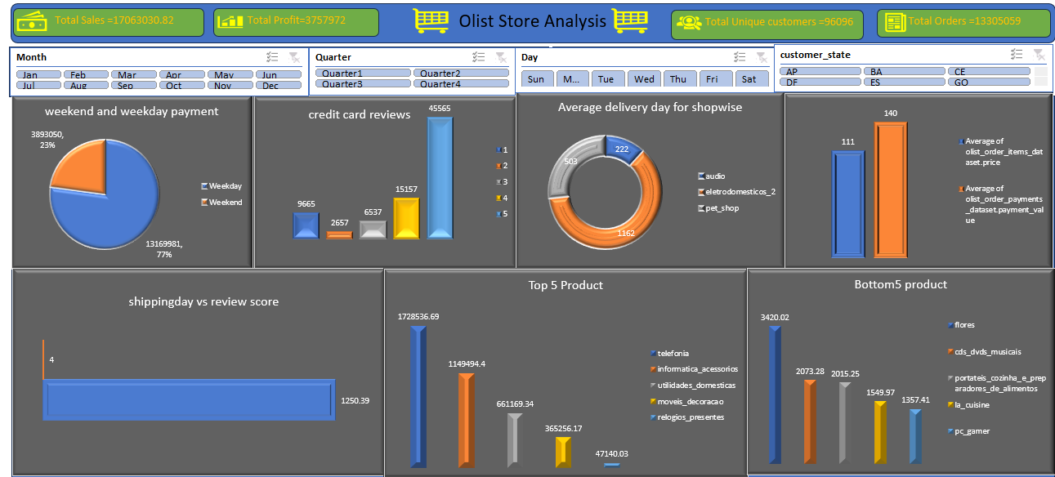
EXCEL

Slide 11
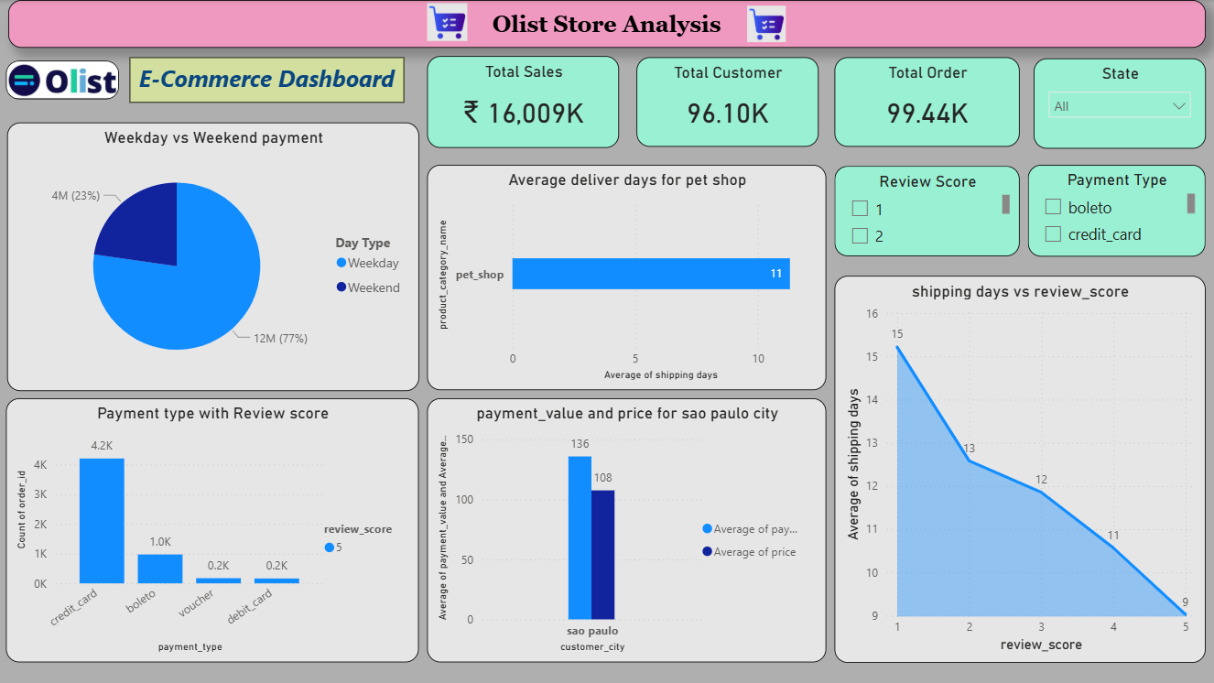
POWER BI

Slide 12
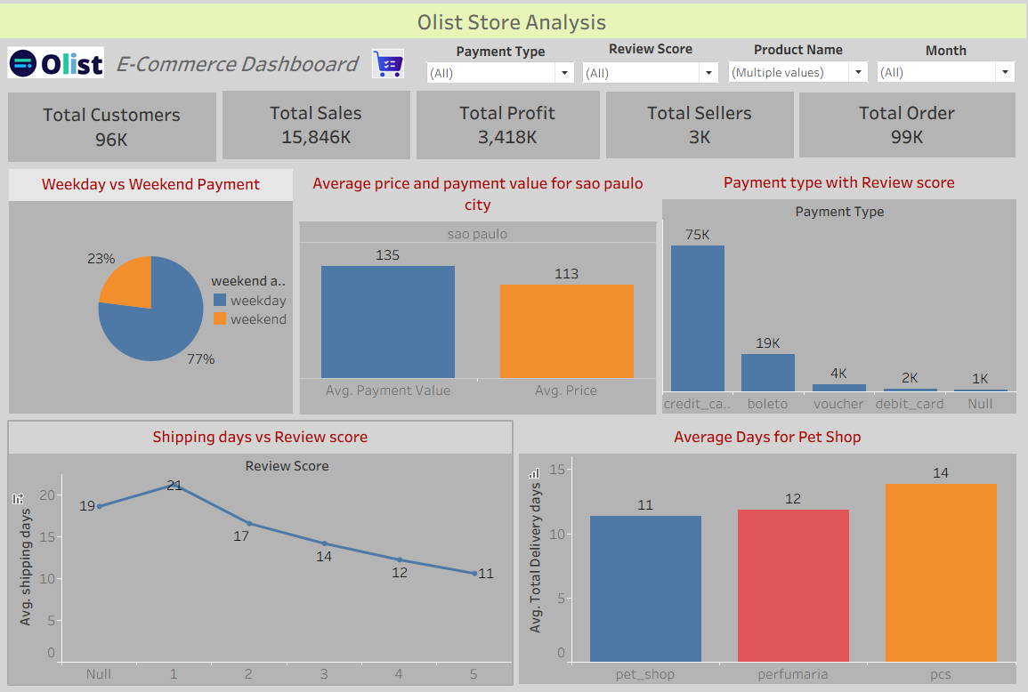
TABLEAU

Slide 13
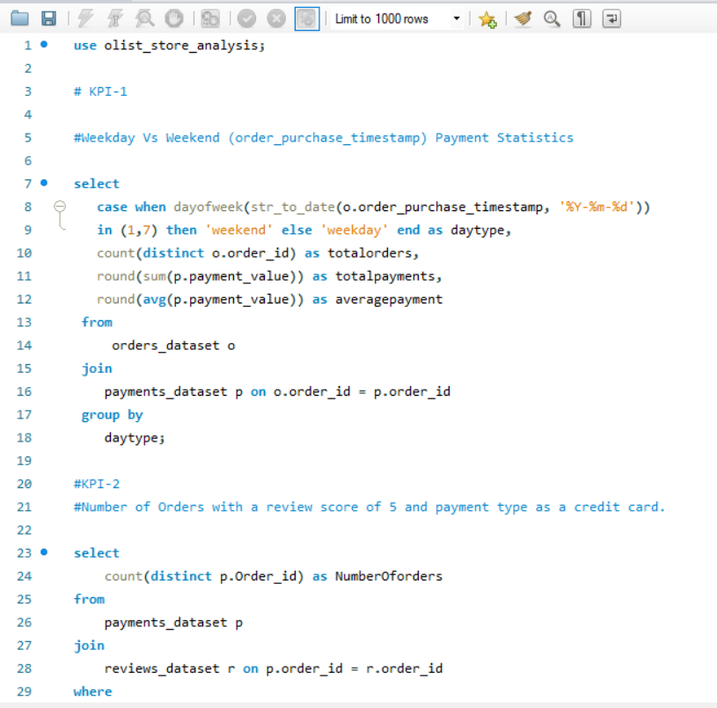
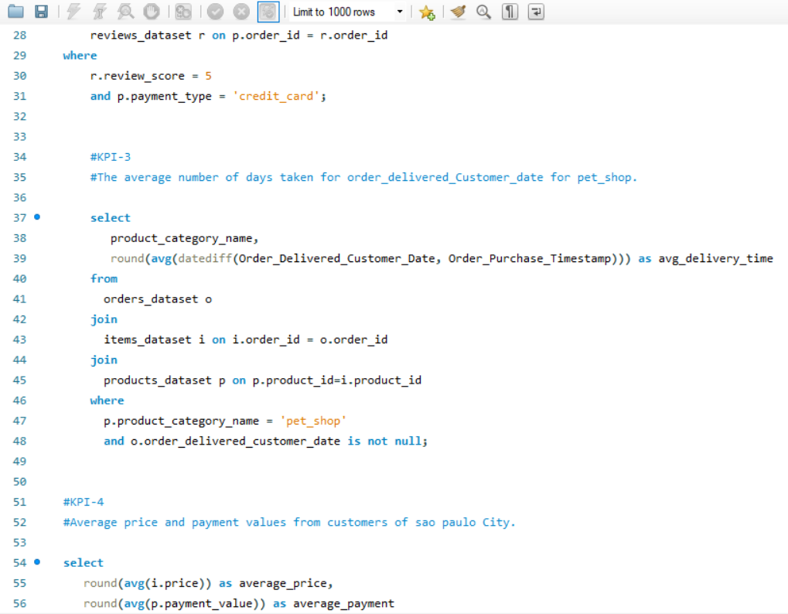
SQL

Slide 14
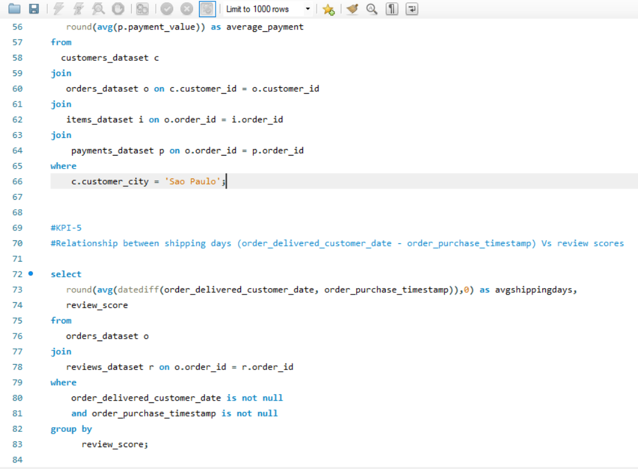

Slide 15
THANK YOU

